Slide 1
Knowledge Recall

Slide 2
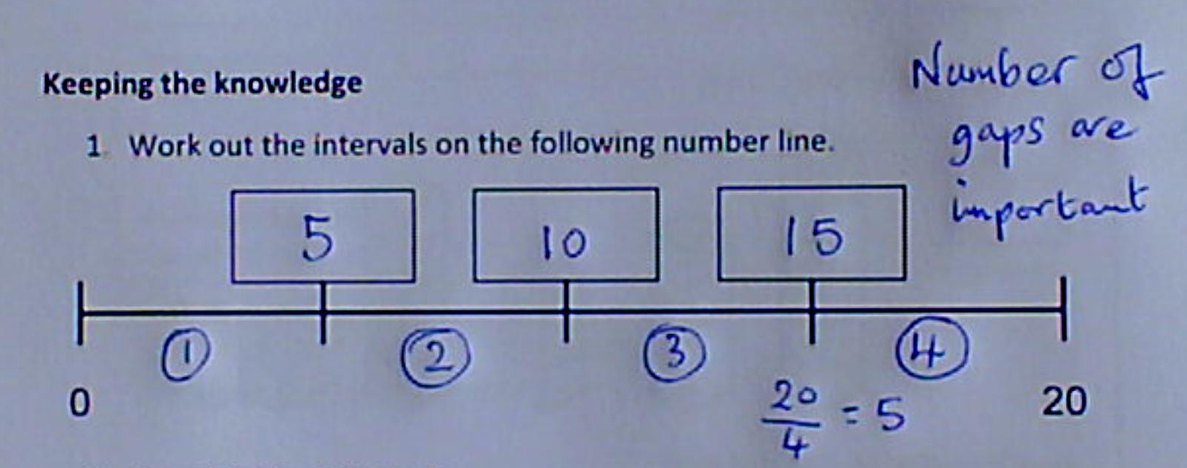
Question 1: Finding intervals

Slide 3
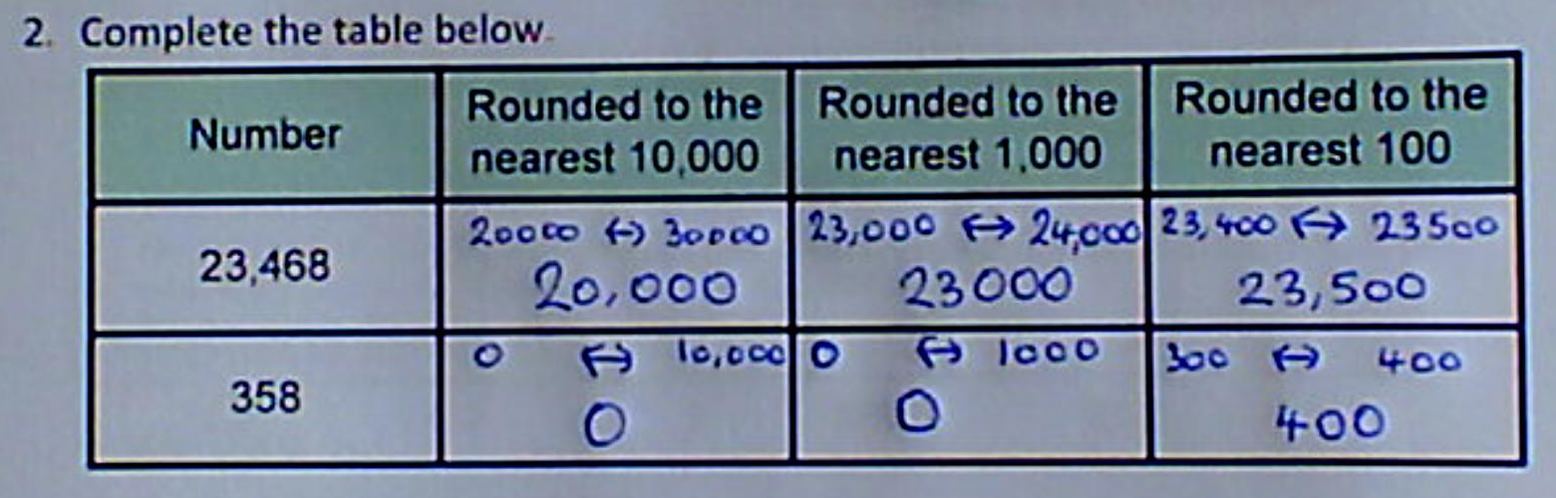
Question 2: Rounding

Slide 4
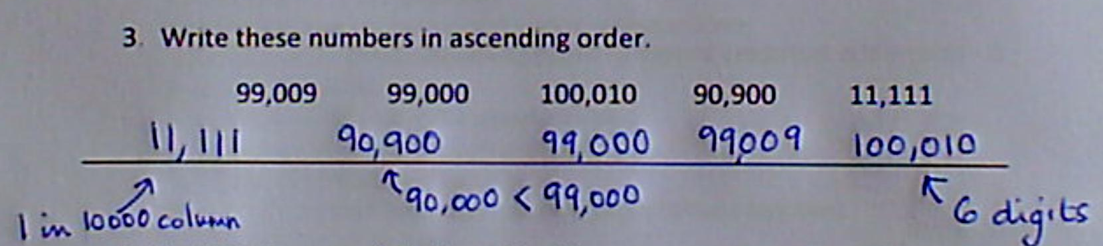
Question 3: Ordering integers

Slide 5
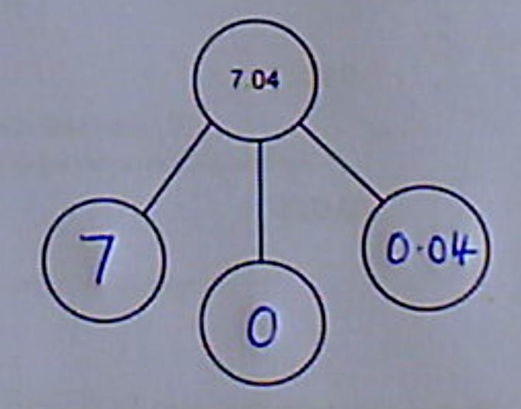
Question 4: Partitioning

Slide 6
Represent tenths and hundredths as diagrams
New Learning

Slide 7
Worth of diagrams
A whole one 1
One tenth 0.1
One hundredth 0.01

Slide 8
Addition of diagrams
3

Slide 9
Addition of diagrams
0.3

Slide 10
Your turn:
0.4 + 0.2 + 0.1 =

Slide 11
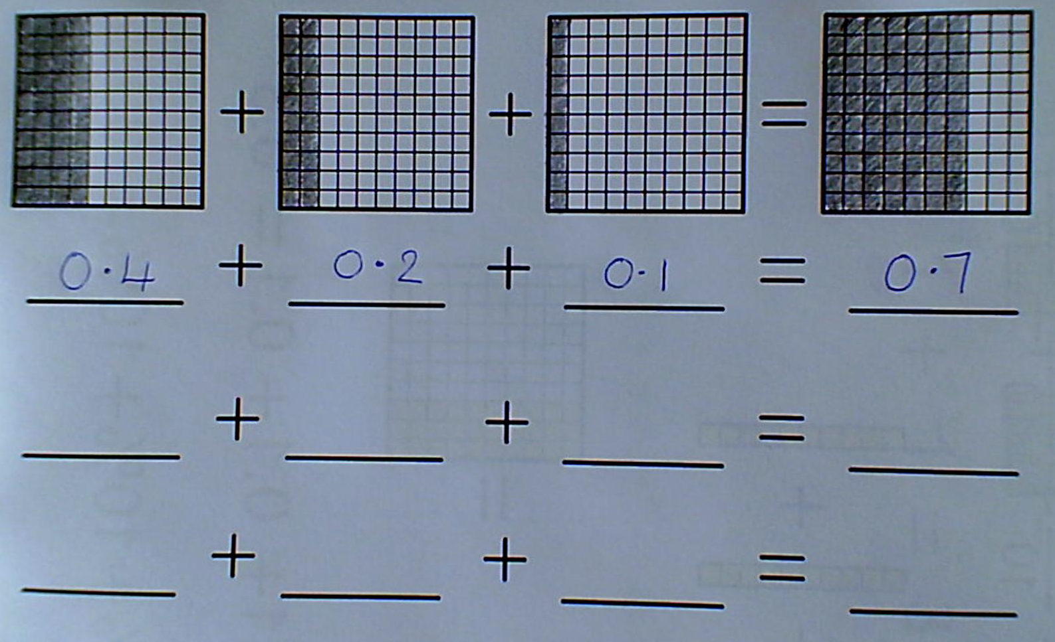
0.4 + 0.2 + 0.1

Slide 12
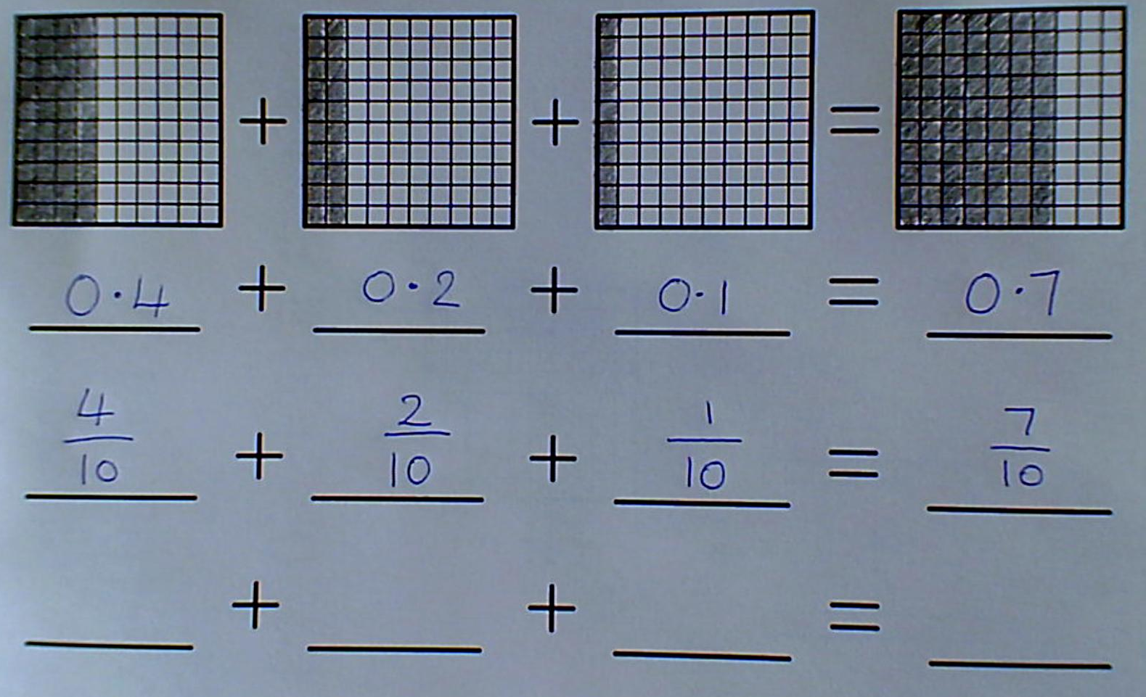

$$\frac{4}{10}+ \frac{2}{10}+ \frac{1}{10}$$

Slide 13
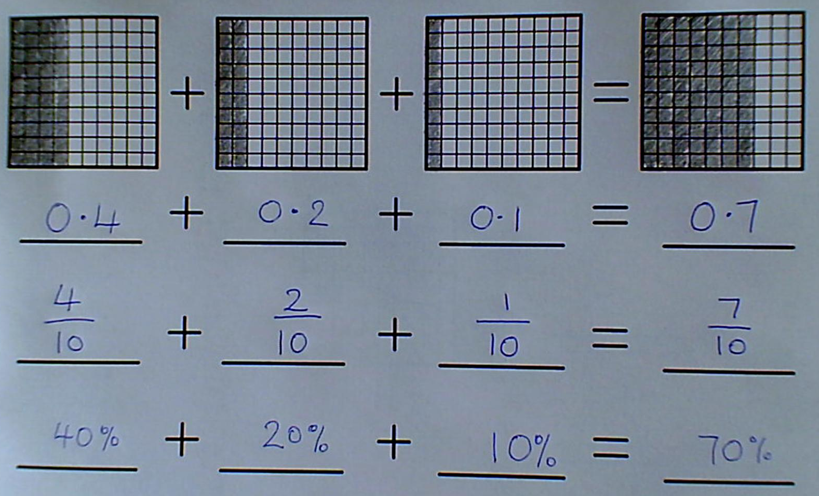
40% + 20% + 10%

Slide 14
Your turn:
0.23 + 0.3 + 0.04 =

Slide 15
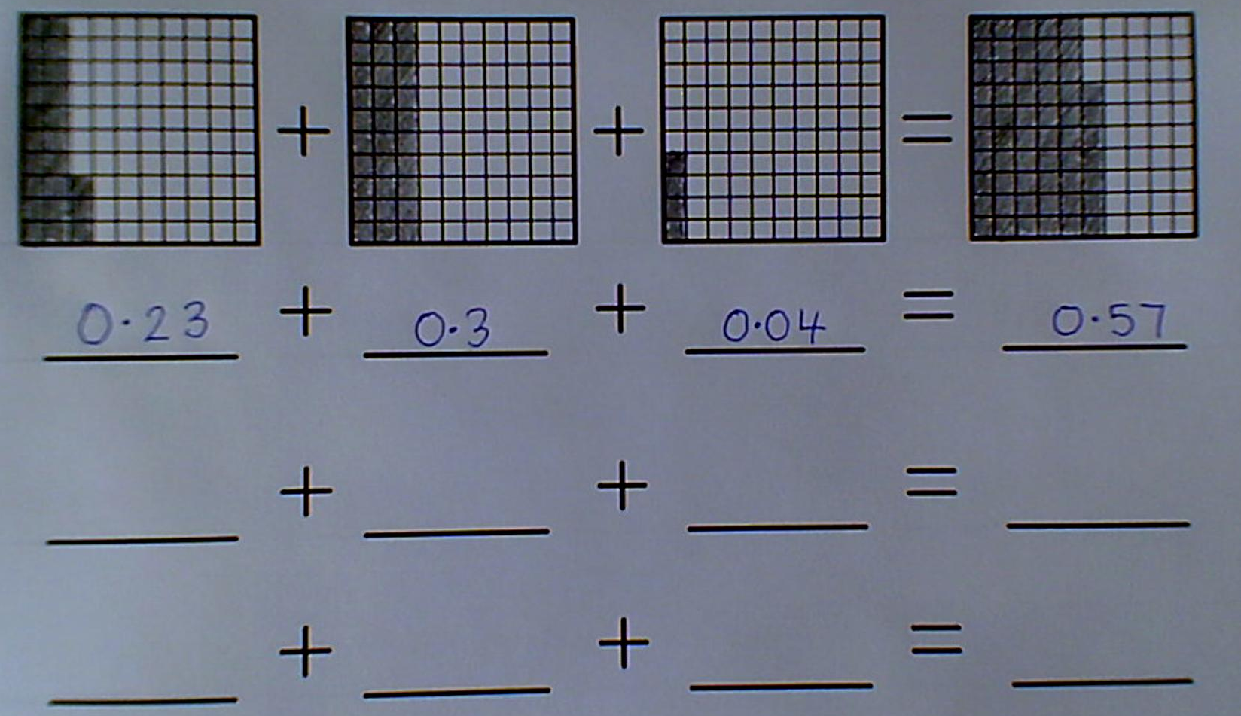
0.23 + 0.3 + 0.04

Slide 16
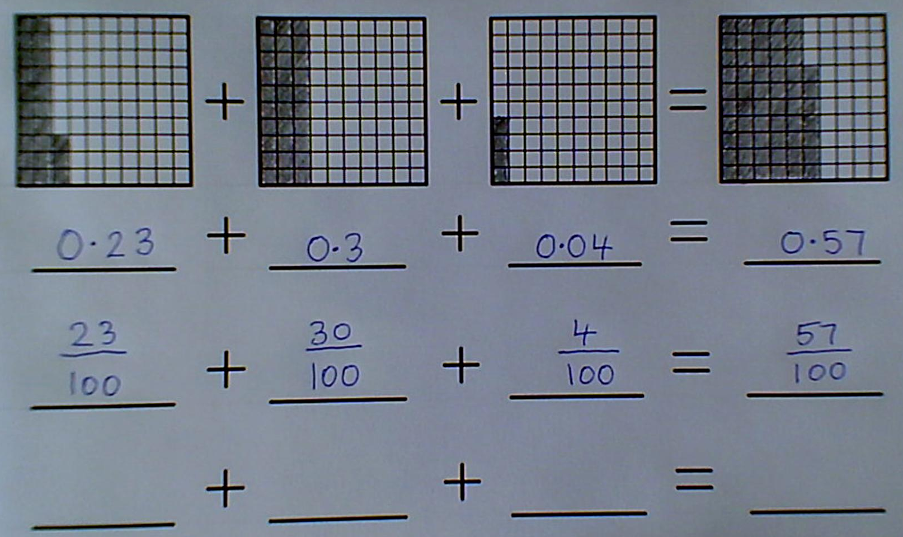

$$\frac{23}{100}+ \frac{30}{100}+ \frac{4}{100}$$
What else could I put here?
Why haven’t I?

Slide 17
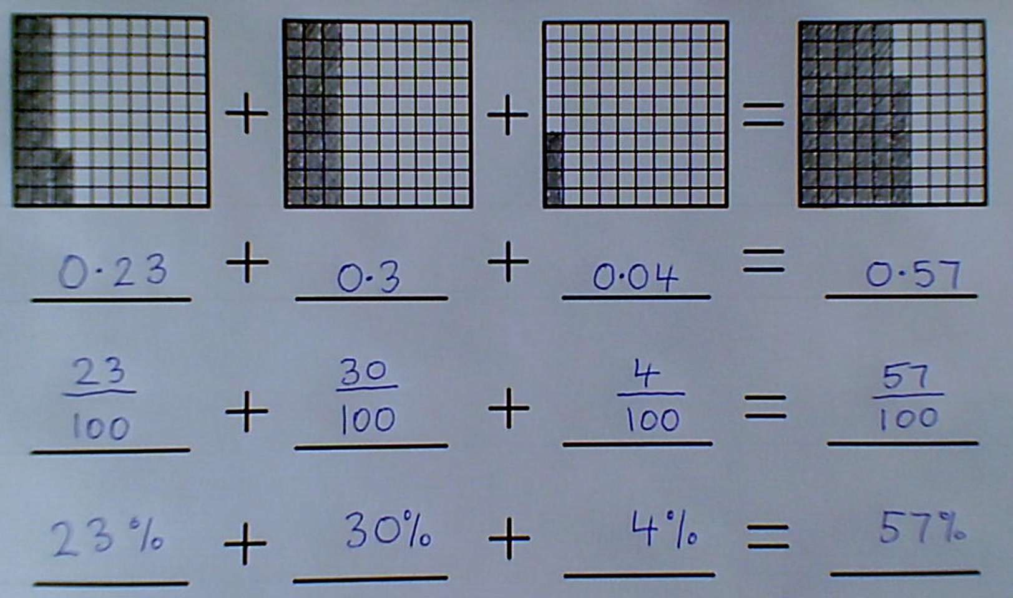
23% + 30% + 4%

Slide 18
Put cards into order
Can you put these cards into order of size?

Slide 19
The answers…

Slide 20
The answers…

Slide 21
Represent tenths and hundredths as diagrams
Who thinks they could do this now?

Slide 22
True or False?

Slide 23
True or False?

Slide 24
True or False?

